Slide 1
Integrated Analytics with Azure Synapse
Exploring Data Analytics with Azure Synapse Analytics Workspace

Slide 2
Azure Synapse Analytics
Azure Synapse is a limitless analytics service that brings together enterprise data warehousing and Big Data analytics.
It gives you the freedom to query data on your terms, using either serverless or dedicated resources—at scale.

Slide 3
Explore Data Analytics Workspace
Define pipelines in Azure Synapse Analytics to transfer data from data sources into the workspace for analysis.
Ingest data in Azure Synapse with Built-in copy task option.
Create a new connection with inputs such as Name, Description, Connect via integration runtime, Base URL Data link for the workspace
Configure the task name and description

Slide 4
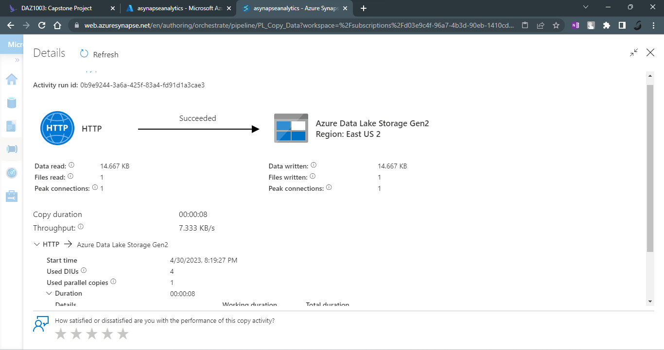

Slide 5
Analyze Data in Azure Synapse Workspace
Use SQL Pool to Analyze Data
Find the TOP 100 rows from New SQL Script from your data in the workspace.
Add HEADER_ROW = TRUE
Update the query by selecting the category and count as Product Numbers.
Update the name of SQL Script by Count Products by category.
Select chart view and make necessary changes.

Slide 6
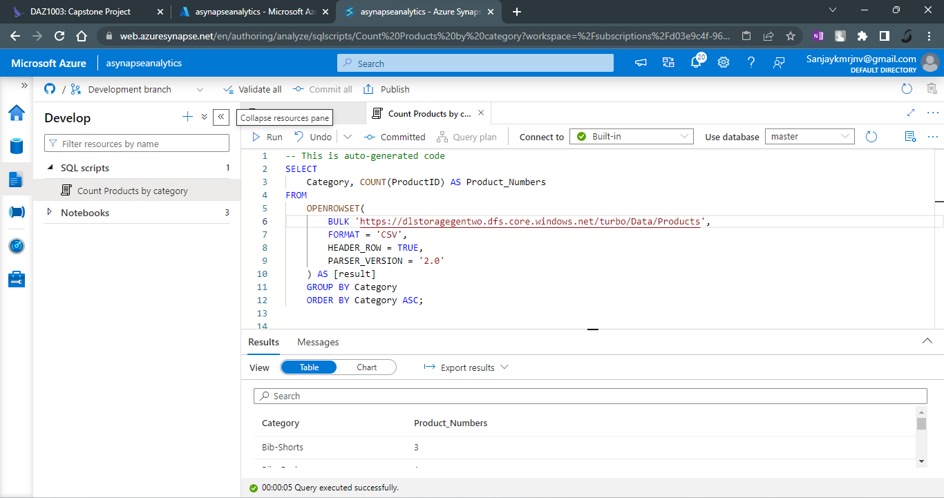

Slide 7
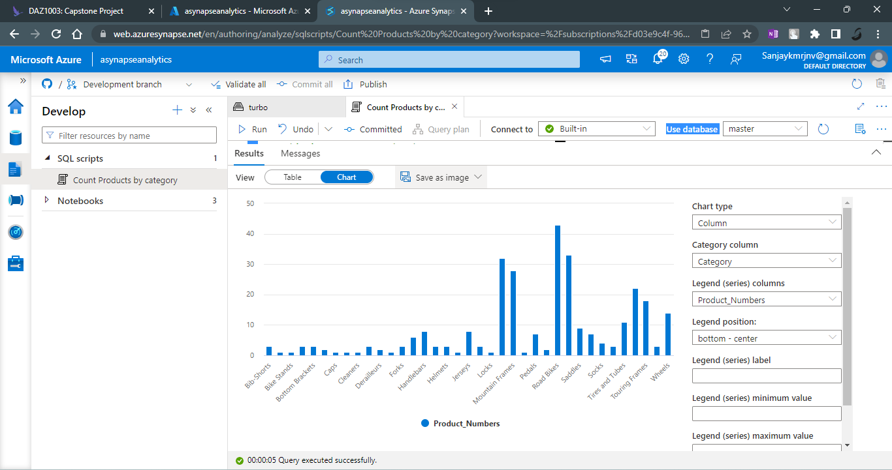

Slide 8
Analyze Data in Spark Pool
Use Spark Pool to Analyze Data
Create a new Spark pool.
Select new notebook and choose Load to dataFrame, language is set as PySpark (Python).
Run the code and check the dataset.
Update the query by selecting the category and count as Product Numbers.
Select chart view and make necessary changes.

Slide 9
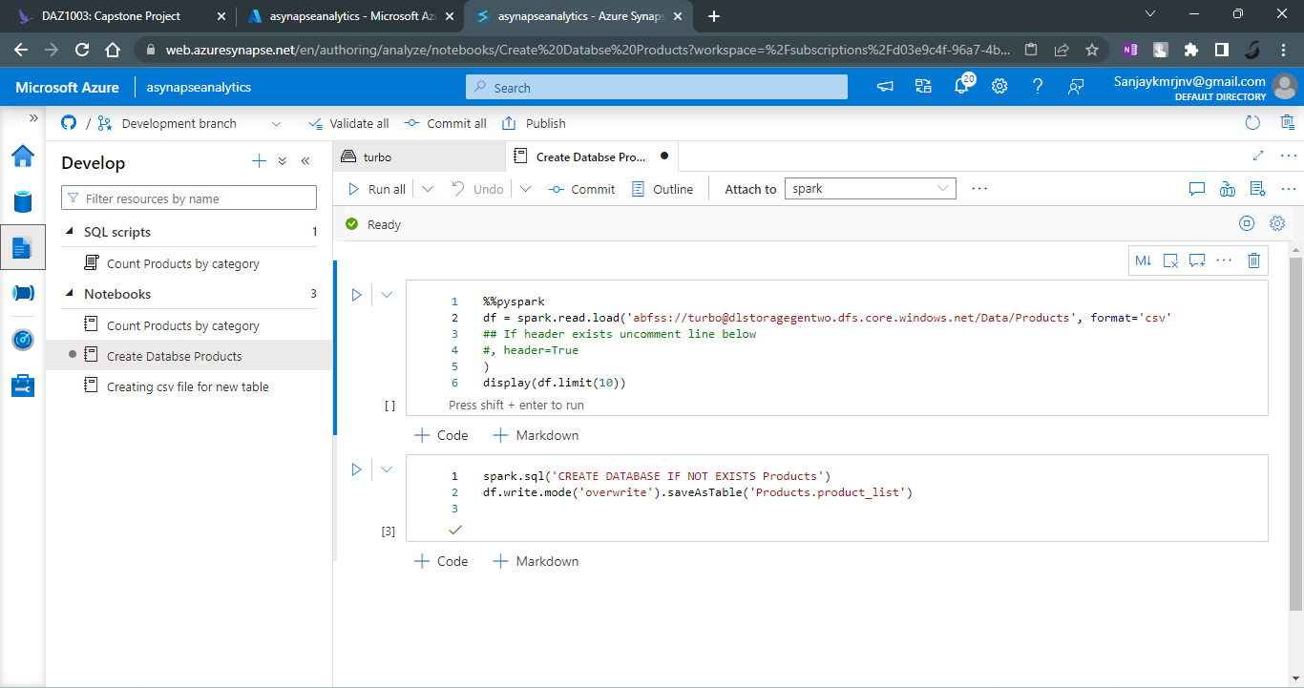

Slide 10
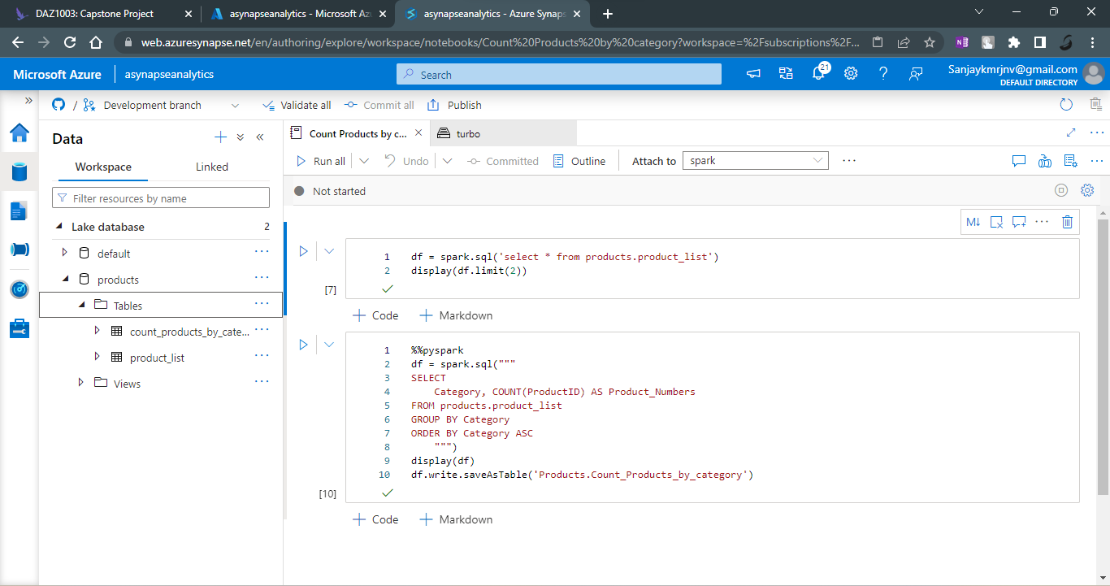

Slide 11
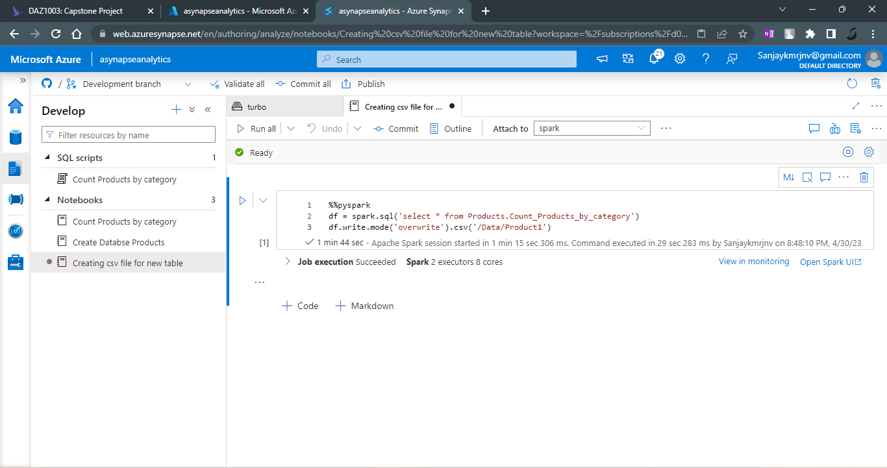

Slide 12
